Slide 1
AI on Complex 3D Surfaces
Nick Miller, Trevor Harron, Charles Boudousquie
7/14/19

Slide 2
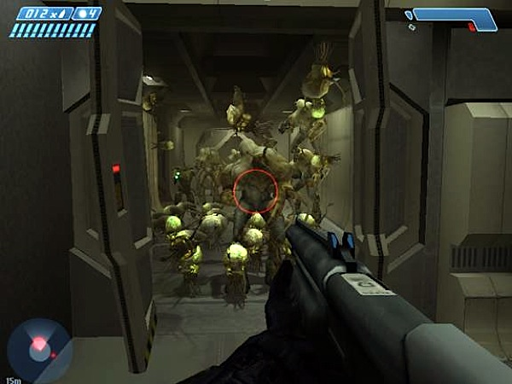
Notes:
For this project we used Unity and C# scripting The reason we used Unity was to leverage the built in mesh capabilities as well as the powerful c# scripting for the behaviors and Algorithms

Slide 3
What was our Goal?
To implement agents that can efficiently navigate the surface of any 3D model
Notes:
outline need (striking agent behavior)
give goal (implement)
*calling it gecko ai

Slide 4
Gecko AI in three steps
Generate the Navmesh
Adapt the Funnel Algorithm
Implement Agent Behavior

Slide 5
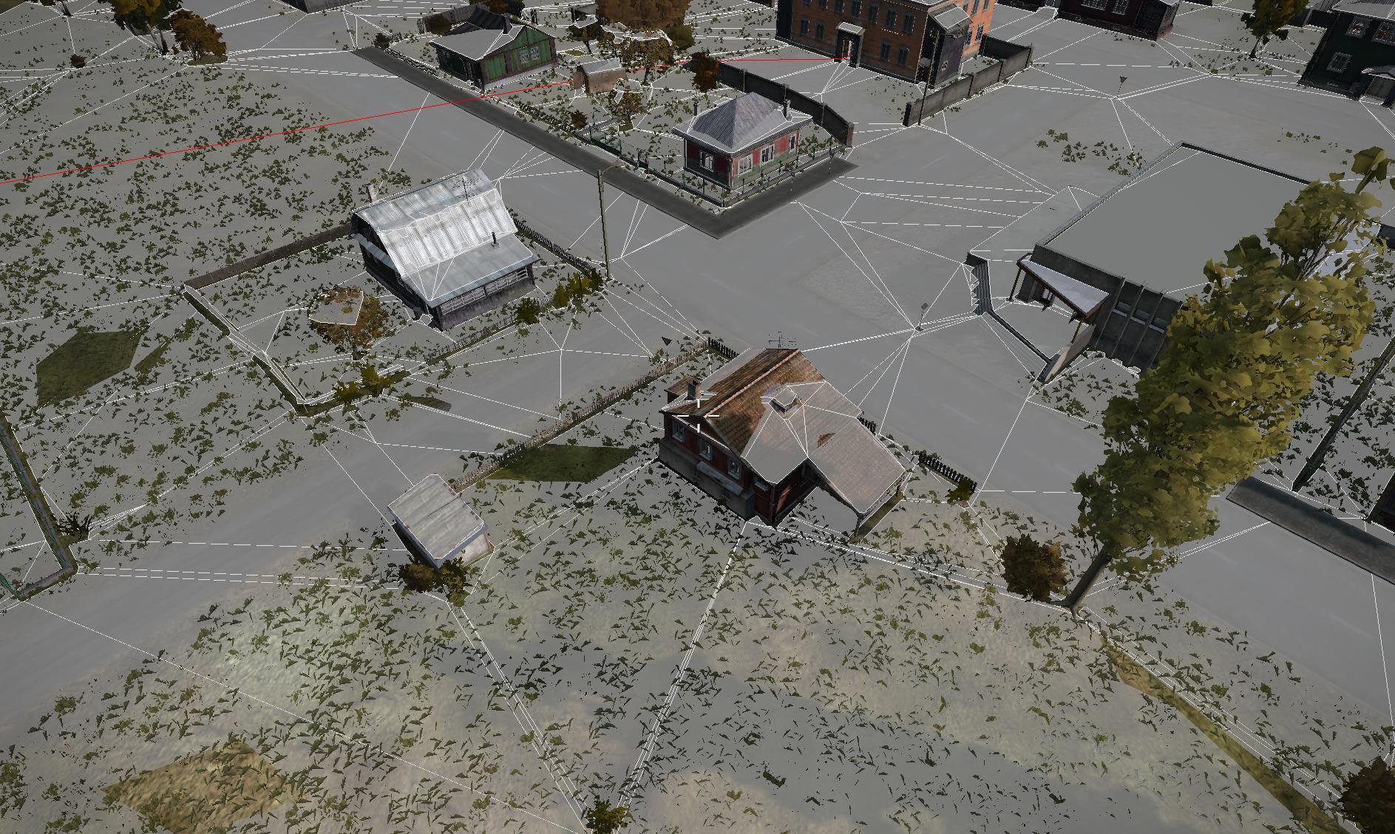
Aren’t Navmeshes flat though?
We’ve got this down!
Notes:
Before we get to the 3D Funneling, we need to have a navmesh that allows us to navigate a complex shape.
Most navmeshes like the one unity can generate are designed for 2D Funneling and a (generally) flat 2.5D navigable surface
So we built our navmesh based on the Unity Mesh object and comprised that mesh of nodes containing the needed positional and directional information
This allowed us to ensure not only the correct movement of the agents but also give us the needed information for terrain analysis The Terrain analysis simply analyzes the players postions and the camera direction reletive to each node to determine the node visibility and distance

Slide 6
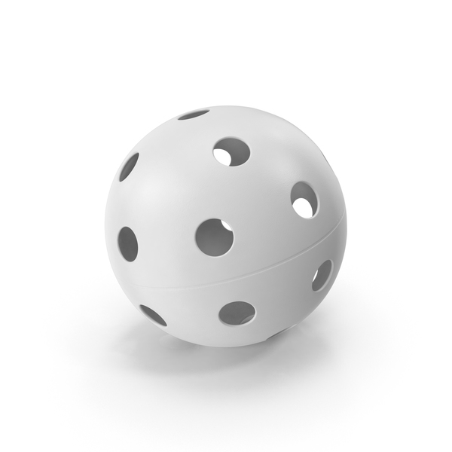
Converting a Surface into a Navmesh
So how did we handle this?
Convert the Surface into triangles
Calculate the node’s geometry
Find the node’s the neighbors
pixelsquid.com

Slide 7
Gecko AI in three steps
Generate the Navmesh
Adapt the Funnel Algorithm
Implement Agent Behavior

Slide 8
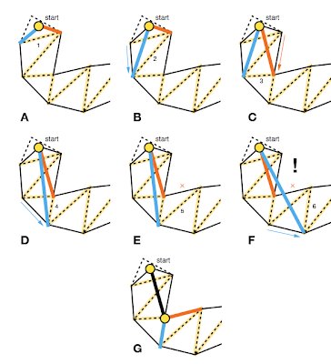
Understanding the funnel algorithm
Source: Stupid Simple Funnel Algorithm by Mikko Mononen
Notes:
start with a navmesh path,
form a ‘funnel’ between the starting point and the first two shared points in the path
check if the next point is within the funnel
if it is, ‘reduce’ the funnel by re-assigning one of the path’s points
if it isn’t, add the newest point to the list of efficient path points and re-initialize the funnel

Slide 9
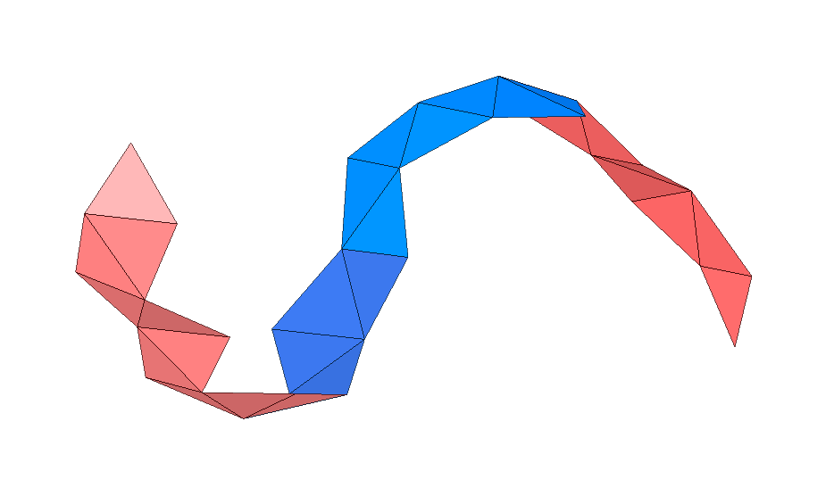
Can we apply the algorithm to a complex navmesh?
Notes:
describe my process for extrapolating in 3d

Slide 10
Extrapolating the funnel algorithm
Get starting line from normal
Get funnel planes from node intersections
Check if next point is in funnel
Set new starting line or reduce funnel
Notes:
note normal of starting node, visualize it as a dotted line
select shared points like with funnel algorithm
take difference of (funnel boundary) and (closest point on normal line to funnel boundary)
use these points to define a ‘funnel’ with planes
check if next point is within the funnel using similar vector
continue as if normal funnel algorithm

Slide 11
Gecko AI in three steps
Generate the Navmesh
Adapt the Funnel Algorithm
Implement Agent Behavior

Slide 12
Behavior Design
Get Distance to Player
Dist < 30
Dist >= 100
30 <= Dist < 50
50 <= Dist < 100
Fly Away
Wander
Look At Player
Hide
Waiting

Slide 13
Terrain analysis can free up resources

Slide 14
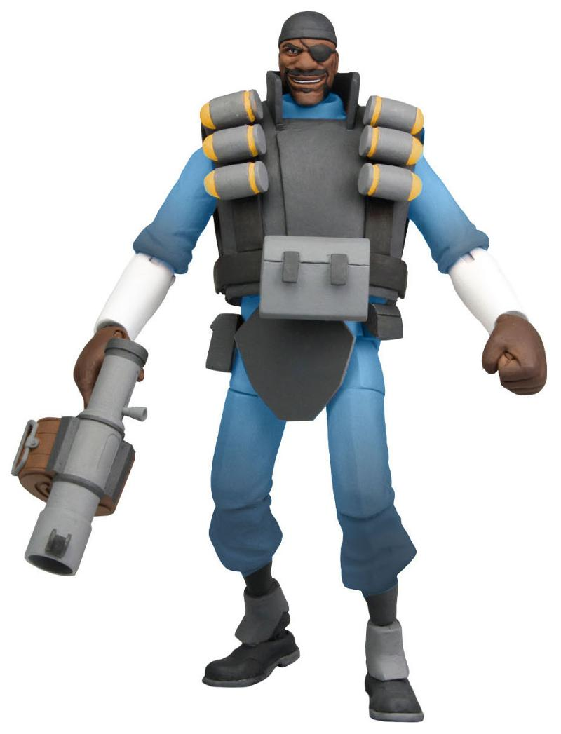
Seeing is believing
Notes:
It’s Demo Time

Slide 15
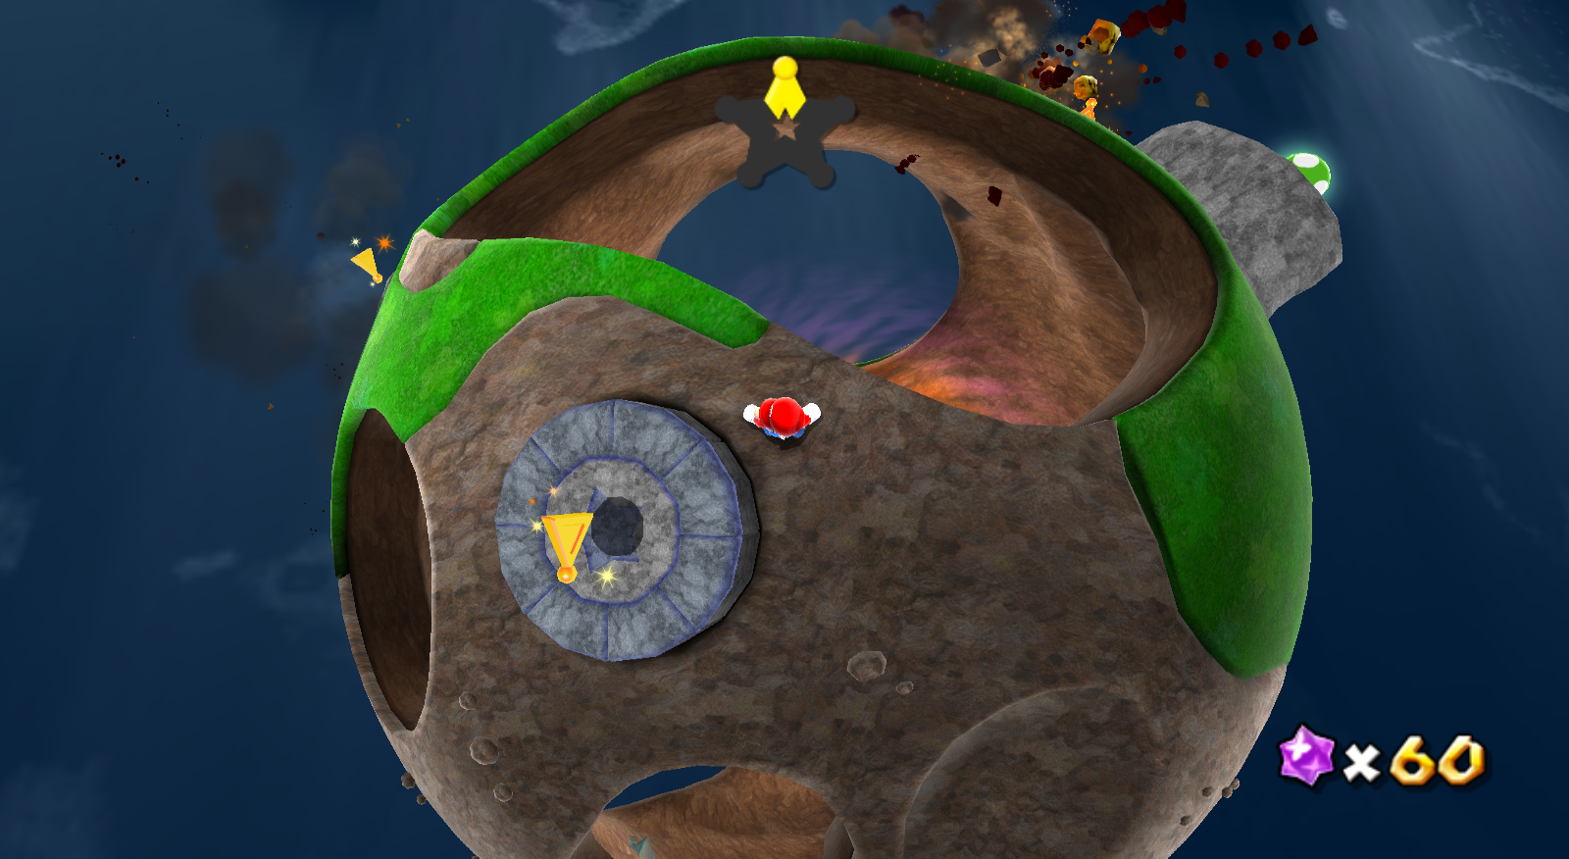
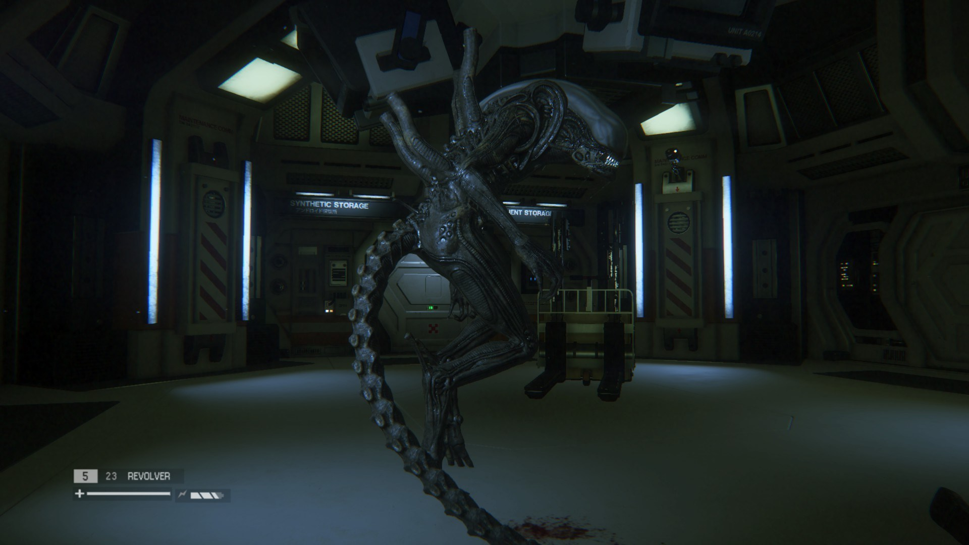
Why does Gecko AI matter?
What if the enemy wants to avoid Mario on this planet?
How can we make this climb the walls and ceiling?

Slide 16
Questions/Comments

